Slide 1
25 Years of Excess Unemployment in Advanced Economies: Lessons for Monetary Policy
Joseph E. Gagnon and Madi Sarsenbayev
PIIE Working Paper 22-17
November 16, 2022 Seminar for The Better Policy Project

Slide 2
The Return of a Major Policy Error?
For 25+ years, central banks in advanced economies allowed unemployment to be higher than needed to keep inflation low, resulting in trillions of dollars of lost output.
This error arose from an incorrect model of inflation combined with inflation targets that were too low.
Central banks should raise their inflation target to at least 3 percent.
They should also place less faith in any one model and instead experiment occasionally to learn how fast economies can grow without high inflation.
These results highlight the usefulness of a dual mandate.

Slide 3
An Important Nonlinearity
The Phillips curve is perhaps the single most important macroeconomic relationship.
Keynes (1936) described this relationship, stating that very high rates of unemployment may persist with little downward effect on wages and prices, but that there is a point below which a low rate of unemployment causes wages and prices to rise.
Phillips (1958) drew an empirical relationship between unemployment and wage growth in the United Kingdom under the Gold Standard.

Slide 4
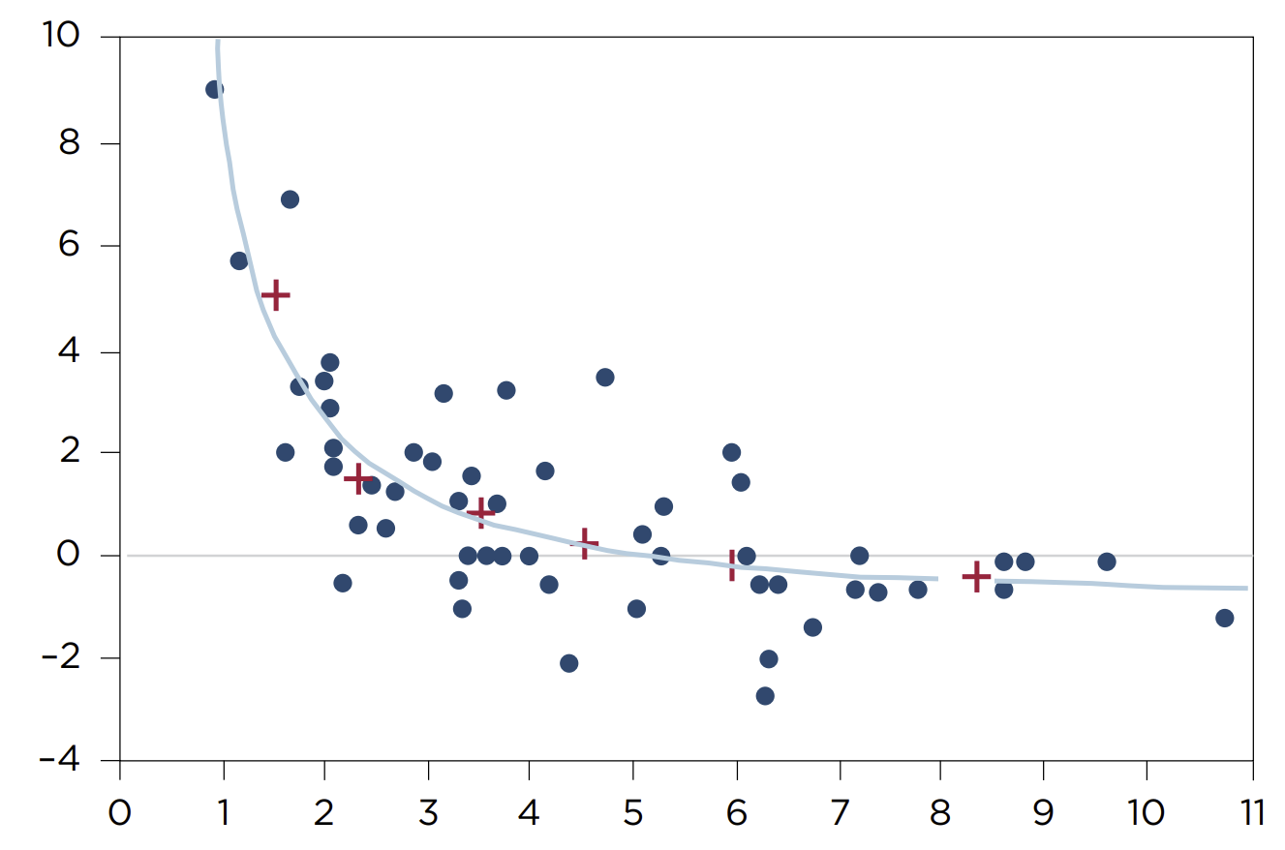
The Original Phillips Curve: United Kingdom, 1861-1913
rate of change of money wage rates, percent per year
unemployment, percent
Source: Phillips (1958), retrieved from Wiley Online Library

Slide 5
Evolution of the Phillips Curve
With higher inflation in the 1970s and 1980s, a linear Phillips curve worked well.
Key issues were controlling for supply shocks and inflation expectations.
The transition to ultra-low inflation in the early 1990s led to a decline in the estimated Phillips curve slope.
Inflation expectations became more anchored.
Theory says that downward wage and price rigidity will bend the Phillips curve when inflation is very low.
Akerlof, Dickens, and Perry (1996), Daly and Hobijn (2014), Aiyar and Voigts (2019), Dupraz, Nakamura, and Steinsson (2022).

Slide 6
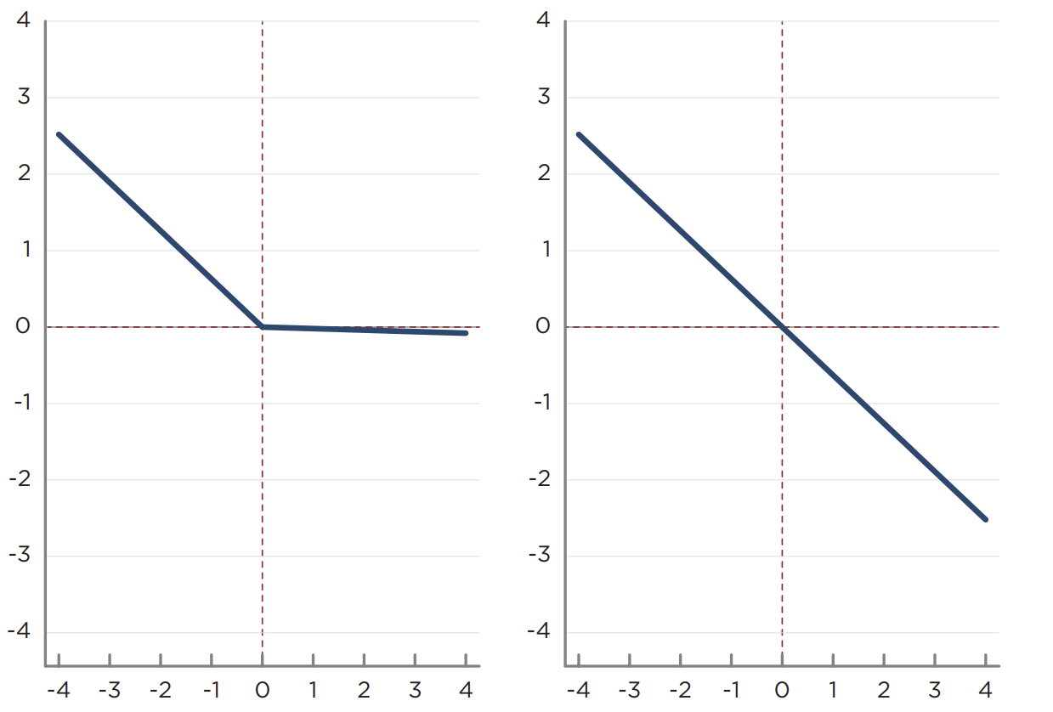
The US Phillips Curve under Low and High Inflation
effect on inflation, percentage points
Low inflation
High inflation
Curves display the effect of the unemployment gap on core CPI inflation after controlling for other factors, such as lagged inflation and import prices.
Inflation is low when inflation averages less than 3 percent over the previous eight quarters.
Gagnon and Collins (2019a)
Forbes, Gagnon, and Collins (2022)
unemployment gap, percent
CPI = consumer price index
Note: The low inflation sample is 1959Q2-1967 Q3 and 1995Q1-2018Q4. The high inflation sample is 1967Q4-1994Q4.
Source: Authors’ calculations based on GAP coefficients from column 4 of table 1 in Gagnon and Collins (2019a).

Slide 7
Implications of a Nonlinear Phillips Curve
Stochastic simulations of nonlinear PC macro model (Dupraz, Nakamura, and Steinsson 2022) say
A low inflation target reduces average employment.
Raising inflation target from 2 to 4 percent reduces unemployment by almost 2 percentage points on average.
When inflation target is low, the payoffs to aggressive central bank stabilization policy are high.
Assumes that central banks know the true model, including U*.

Slide 8
Nonlinear Phillips Curves and Model Uncertainty
Aiyar and Voigts (2019) show that conventional methods of estimating U* are biased upwards when the Phillips curve is nonlinear.
U > U* most of the time, yet methods set Average(U*) → Average(U) over time.
Fed Chair Powell (2018) worried about estimates of R* and U*.
He did not support monetary tightening even though U < U*^{E} .
In 2019, with U < U*^{E}, Fed lowered R below R*^{E} because core inflation ticked down.
The COVID pandemic eclipsed these developments.
We’ll return to lessons from the COVID inflation….
But for now, let’s focus on the 1990s through 2019.

Slide 9
The Great Disinflation of the 1990s
three-year moving average of PCE inflation, percent, 1970-2019
PCE = personal consumption expenditures
Source: Organization for Economic Cooperation and Development, Economic Outlook database, No. 110, December 2021

Slide 10
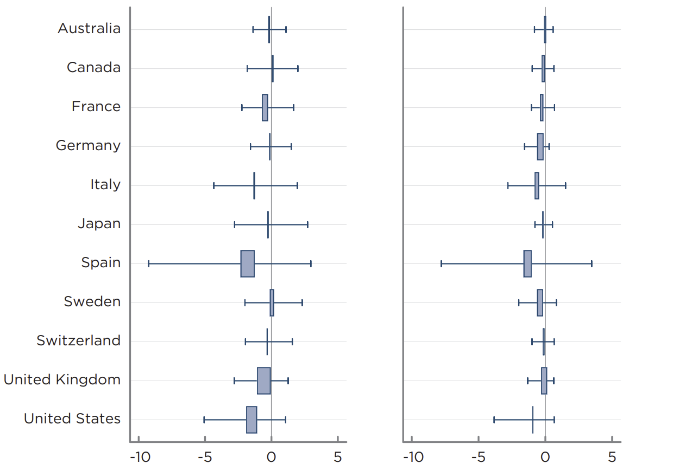
IMF and OECD Gaps Mainly Negative, 1995-2019
Output gap
Employment gap
Boxes span the averages over time of two different measures of the gap.
Whiskers span the 10th to 90th percentiles of annual observations.
Note: Boxes on the left panel span the distance between mean values of output (GDP) gaps retrieved from the IMF and OECD Fall 2021 databases. Boxes on the right panel span the distance between mean values of the employment gaps calculated from the OECD Fall 2020 and Fall 2021 databases. The IMF does not estimate employment gaps nor does it estimate an output gap for Switzerland. Whiskers display averages across two gap measures of the 10th percentile (left whisker) and 90th percentile (right whisker) values.
Sources: International Monetary Fund, World Economic Outlook database, October 2021; and Organization for Economic Cooperation and Development, Economic Outlook database, No. 110 (December 2021) and No. 108 (December 2020).
percent

Slide 11
True Gaps Are Even More Negative
Rare examples of large positive IMF and OECD gaps had no discernable impact on inflation.
Italy, Spain, and Sweden in mid-2000s.
Japan in mid-1990s.
United States in 2000.
Gaps have been revised up over time wherever subsequent growth and employment have turned out weak.
Estimation methods do not allow for long periods on one side of zero.
Italy and Spain had 2007 gaps near zero in real time, consistent with low inflation.

Slide 12
Estimated U* Smooths through Actual U, 1990-2019
percent
Source: Organization for Economic Cooperation and Development, Economic Outlook database, No. 108, December 2020.

Slide 13
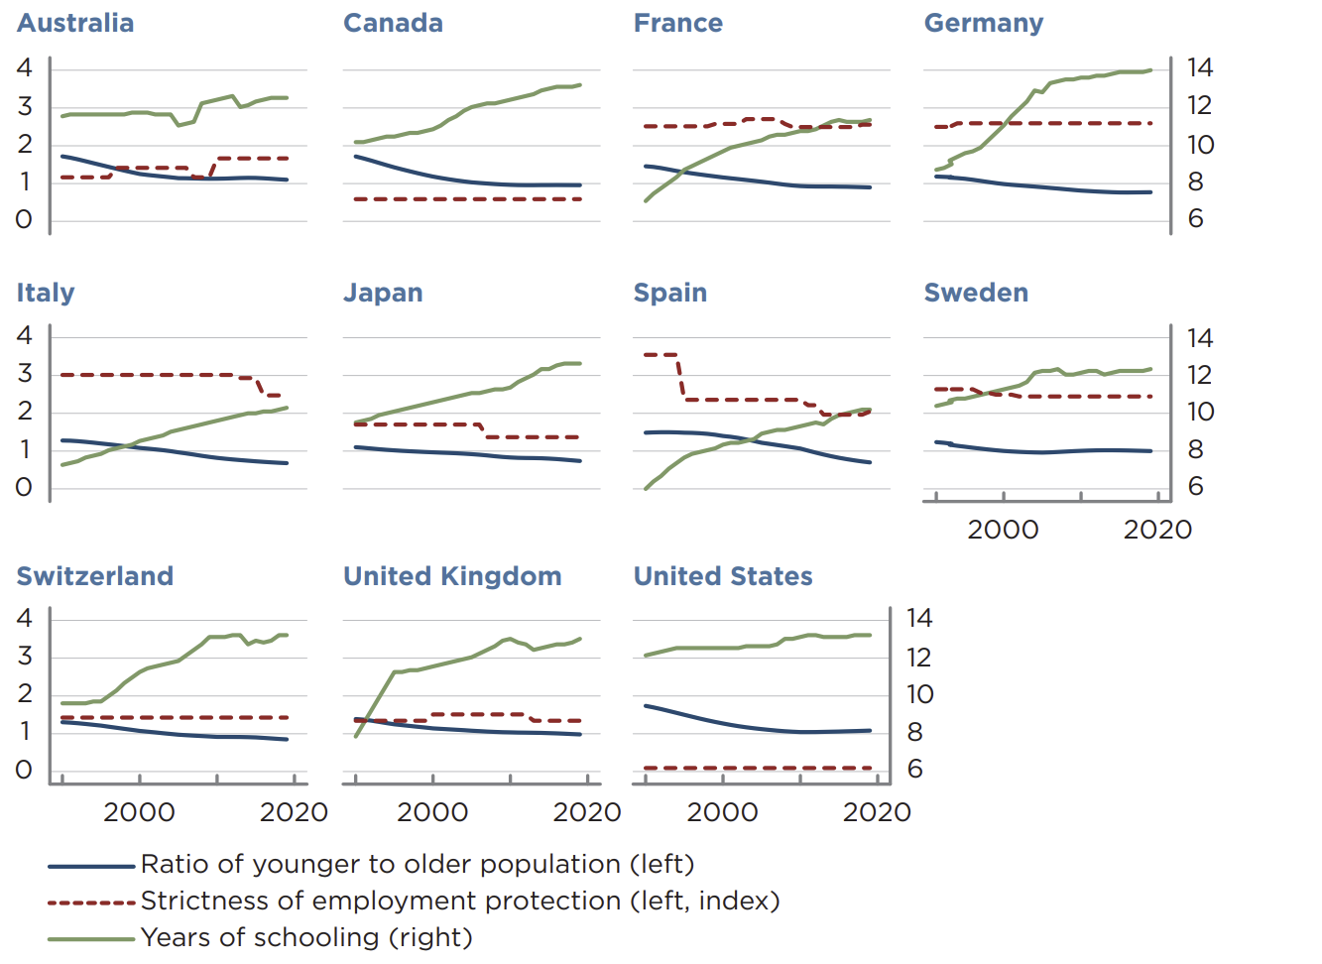
Yet Fundamentals Suggest Monotonic Declines in U*
ratio/index
years
Declining youth ratio (blue) should lower U*.
Rising education (green) should lower U*.
Declining employment protection (red) should lower U* (Australia is exception).
1990-2019
Note: The figure displays (1) the ratio of the population aged 15-34 to the population aged 45-64, (2) the strictness of employment protection legislation (version 1, which has the longest available history of the four versions published by the OECD), and (3) the average number of years of education received by people ages 25 and older.
Sources: Organization for Economic Cooperation and Development, OECD Indicators of Employment Protection; United Nations, Department of Economic and Social Affairs, Population Division, World Population Prospects 2019, Online Edition, Rev. 1; and United Nations Development Programme, Human Development Data Center.

Slide 14
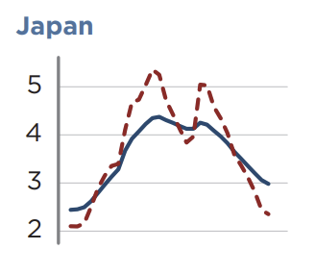
Case Study of Japan U*, 1990-2019
percent
OECD Economic Survey of Japan 2005 notes rising labor market dualism and outsourcing.
OECD Economic Survey of Japan 2019 says labor market dualism and outsourcing continued to increase. No explanation provided for fall in U*.
Published U*
Unemployment rate
Source: Organization for Economic Cooperation and Development, Economic Outlook database, No. 108, December 2020.

Slide 15
Estimated Linear Phillips Curve Flattens after 1994
1970-1994
1995-2019
Variables | PCE inflation | GDP inflation | PCE inflation | GDP inflation
Lagged inflation | 0.61** 0.06 | 0.50** 0.07 | 0.47** 0.06 | 0.29* 0.11
Unemployment rate | -0.35** 0.05 | -0.44** 0.07 | -0.06* 0.02 | -0.13* 0.05
Youth ratio | 1.97 1.00 | 2.06 1.23 | 1.36 0.42 | 1.20 0.95
Change in VAT | 0.42 0.24 | 0.69** 0.16 | 0.30 0.14 | 0.21 0.17
Within R² | 0.87 | 0.83 | 0.64 | 0.45
Observations | 236 | 236 | 275 | 275
Long-run Phillips curve slope | -0.89** 0.17 | -0.88** 0.16 | -0.12** 0.04 | -0.18** 0.06
p<0.05, ** p<0.01
Note: The long-run slope is calculated by dividing the unemployment rate coefficient by (1 minus the lagged inflation coefficient). Youth ratio is the ratio of the population aged 15 to 34 years relative to those aged 45 to 64 years. VAT is goods and services tax revenues as a percent of personal consumption expenditures. Standard errors (in blue) are clustered by country. All regressions
include a full set of country and year fixed effects. Within R² excludes impact of country fixed effects. The 11 countries are Australia, Canada, France, Germany, Italy, Japan, Spain, Sweden, Switzerland, United Kingdom, United States.
Sources: Authors’ calculations based on data from Organization for Economic Cooperation and Development, Economic Outlook database (No. 110, December 2021), Annual National Accounts database, and Revenue Statistics database; United Nations, Department of Economic and Social Affairs, Population Division, World Population Prospects 2019, Online Edition, Rev. 1; and Freund and Gagnon (2017).

Slide 16
Monte Carlo Simulations of a Bending Phillips Curve
effect on inflation, percentage points
Low inflation
High inflation
Regression 1: Inflation follows a linear process defined by the averages of the coefficients in the first two columns of the previous table (right panel).
Regression 2: Inflation follows a nonlinear process (left panel). Slope when gap<0 is identical to regression 1. Slope when gap>0 is -0.02.
Regression 3: Same as regression 2 except that mean of gap is 2.5 (1 standard deviation).
unemployment gap, percent
Note: The panels are illustrative only and not drawn to scale.
.

Slide 17
Simulated Linear Phillips Curve Slope Estimates
Dependent variable is inflation
Linear model
Nonlinear model
Mean of unemployment gap
Variables | 0 | 0 | 2.5
Lagged inflation | 0.54** 0.06 | 0.53** 0.08 | 0.53** 0.09
Unemployment gap | -0.40** 0.04 | -0.21** 0.04 | -0.08 0.04
Constant | 0.93** 0.16 | 1.33** 0.24 | 1.17** 0.23
R² | 0.64 | 0.43 | 0.31
Observations | 99 | 99 | 99
* p<0.05, ** p<0.01
Note: Simulated data are generated by taking random draws on unemployment gap (mean 0 in columns 1 and 2, mean 2.5 in column 3, standard deviation 2.5 in all columns) and shock to inflation (mean 0,
standard deviation 1). Each column presents average results from 1,000 linear regressions run on a sample of 99 observations. Standard errors are in blue.
Source: Authors’ calculations based on simulated data.

Slide 18
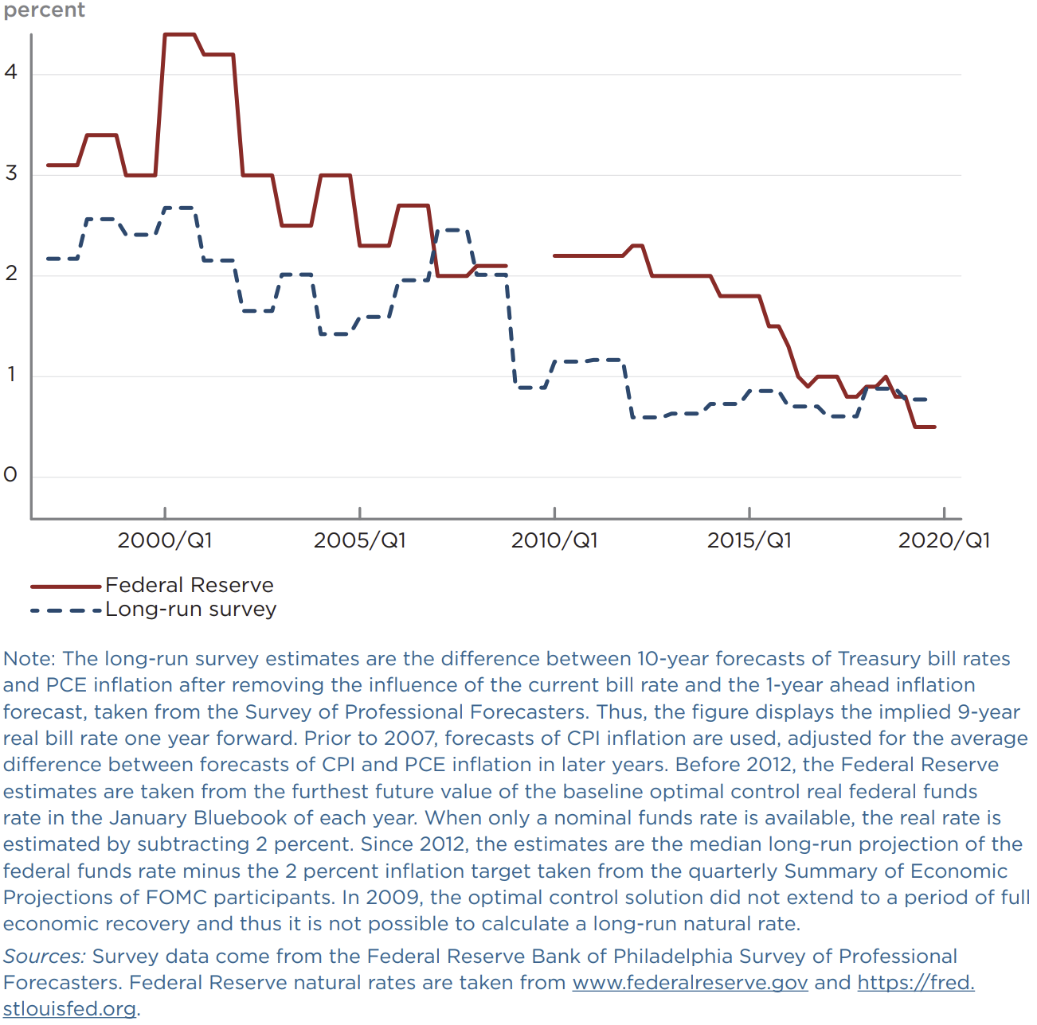
Overestimation of R*
percent
Federal Reserve is long-run real funds rate from Bluebooks (pre-2012) and Summary of Economic Projections (since 2012).
Long-run survey is 9-year real T-bill rate 1 year forward from Survey of Professional Forecasters.
Federal Reserve
Long-run survey
Note: The long-run survey estimates are the difference between 10-year forecasts of Treasury bill rates and PCE inflation after removing the influence of the current bill rate and the 1-year ahead inflation forecast, taken from the Survey of Professional Forecasters. Thus, the figure displays the implied 9-year real bill rate one year forward. Prior to 2007, forecasts of CPI inflation are used, adjusted for the average difference between forecasts of CPI and PCE inflation in later years. Before 2012, the Federal Reserve estimates are taken from the furthest future value of the baseline optimal control real federal funds rate in the January Bluebook of each year. When only a nominal funds rate is available, the real rate is estimated by subtracting 2 percent. Since 2012, the estimates are the median long-run projection of the federal funds rate minus the 2 percent inflation target taken from the quarterly Summary of Economic Projections of FOMC participants. In 2009, the optimal control solution did not extend to a period of full economic recovery and thus it is not possible to calculate a long-run natural rate.
Sources: Survey data come from the Federal Reserve Bank of Philadelphia Survey of Professional Forecasters. Federal Reserve natural rates are taken from www.federalreserve.gov and https://fred.stlouisfed.org.

Slide 19
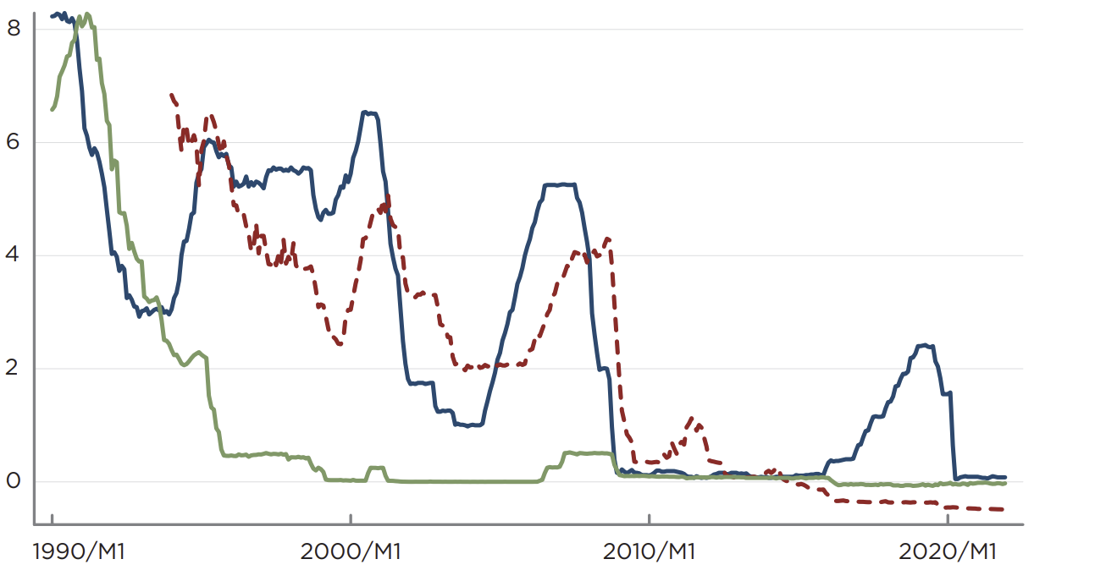
Monetary Policy Constrained by Zero Lower Bound
percent
Japan
Euro area
United States
Note: The figure shows the effective federal funds rate for the United States, the EONIA rate for the euro area, and the call money/interbank rate for Japan.
Sources: Board of Governors of the Federal Reserve System, European Central Bank, and Organization for Economic Cooperation and Development (Main Economic Indicators database), accessed via Macrobond.

Slide 20
Estimated True Unemployment Gaps
percent
Note: Estimates of the true unemployment gap are based on the difference between actual unemployment and an estimate of the natural rate, U*, that is constant over time except for a moderate decline in proportion to the aging of the population. U* is set equal to a centered three-year moving average of actual unemployment in the year in which a centered three-year moving average of ageadjusted unemployment reached its lowest level over the period 1992-2018. From this year, U* is adjusted backwards and forwards by two times the change in the ratio of the population aged 15-34 to the population aged 45-64 relative to its value in the base year. The OECD unemployment gaps are the December 2020 published values.
Sources: Authors’ calculations based on data from Organization for Economic Cooperation and Development, Economic Outlook database, No. 110 (December 2021) and No. 108 (December 2020), and data from United Nations, Department of Economic and Social Affairs, Population Division, World Population Prospects 2019, Online Edition, Rev. 1.

Slide 21
Policy Implications
Raising inflation target modestly, to 3 or 4 percent, would make Phillips curve less nonlinear and U* easier to estimate.
The tendency for U>U* would be reduced (Dupraz, Nakamura, and Steinsson 2022).
The zero lower bound on interest rates would bind less often (Gagnon and Collins 2019b).
Central banks should use a suite of models, including some with nonlinear equations, and not place too much emphasis on estimates of R* and U*.
There is a benefit to experimentation in policy to ascertain true values of R* and U* (Wieland 2003; Powell 2018).

Slide 22
Future Research: COVID Inflation as Evidence for a Steep Segment of the Phillips Curve
COVID raised U* because workers feared getting sick, schools closed, some have “Long COVID”, some retired early, and some reassessed their careers.
U* is now falling but remains higher than 2019—high job vacancy rates.
High rates of quits and job turnover also raises U*.
COVID shifted demand from services to goods.
The magnitude is unprecedented and has not completely reversed.
Goods sectors pushed onto steep segment of Phillips curve—raising inflation more than weak services demand lowered it.
If aggregate Phillips curve is built up from sectoral curves, then sectoral demand dispersion has no effect if curves are linear but is inflationary if curves are nonlinear.

Slide 23
References
Aiyar, Shekhar, and Simon Voigts. 2019. The Negative Mean Output Gap. IMF Working Paper WP/19/183. Washington: International Monetary Fund.
Akerlof, George, William Dickens, and George Perry. 1996. The Macroeconomics of Low Inflation. Brookings Papers on Economic Activity 1: 1-76.
Daly, Mary, and Bart Hobijn. 2014. Downward Nominal Wage Rigidities Bend the Phillips Curve. Journal of Money, Credit, and Banking 46 (no. 2, supplement): 51-93.
Dupraz, Stephane, Emi Nakamura, and Jon Steinsson. 2022. A Plucking Model of Business Cycles. Manuscript at University of California at Berkeley dated February 16.
Forbes, Kristin, Joseph Gagnon, and Christopher Collins. 2022. Low Inflation Bends the Phillips Curve around the World. Economia 45, no. 89: 52-72.
Gagnon, Joseph, and Christopher Collins. 2019a. Low Inflation Bends the Phillips Curve. PIIE Working Paper 19-6. Washington: Peterson Institute for International Economics.

Slide 24
References (cont’d.)
Gagnon, Joseph, and Christopher Collins. 2019b. Are Central Banks Out of Ammunition to Fight a Recession? Not Quite. PIIE Policy Brief 19-18. Washington: Peterson Institute for International Economics.
Keynes, John Maynard. 1936. The General Theory of Employment, Interest, and Money. London: Palgrave Macmillan.
Phillips, Alban William. 1958. The Relation between Unemployment and the Rate of Change of Money Wage Rates in the United Kingdom, 1861-1957. Economica 25: 283-99.
Powell, Jerome. 2018. Monetary Policy in a Changing Economy. Speech at Jackson Hole Symposium, August 24.
Wieland, Volker. 2003. Monetary Policy and Uncertainty about the Natural Unemployment Rate. CFS Working Paper No. 2003/05. Frankfurt: Center for Financial Studies.

Slide 25
Thank you!

